Slide 1
Modeling and Verifying Automated Machine Learning Models
Submitted by : Sanchit Kumar
Submitted to : Dr. Jamal Bentahar

Slide 2
Problem Statement
A lot of organizations have been deploying real time processing analytics engines to provide the best services to their users.
The verification of such models still remains the challenge.
Manual Validations of such systems is almost impossible.

Slide 3
Tools and Development Environment
Model checker – Uppaal (Version – 4.1.22) (32-bit version)
OS – Windows 10
Verification Language – CTL
Properties Verified – Reachability, Safety and Liveness.

Slide 4
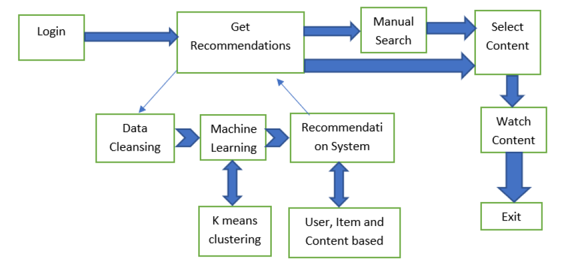
Model

Slide 5
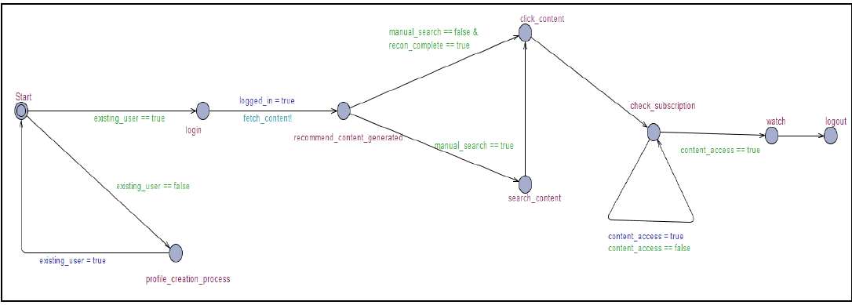
Model Design in Uppaal
Template – front_end

Slide 6
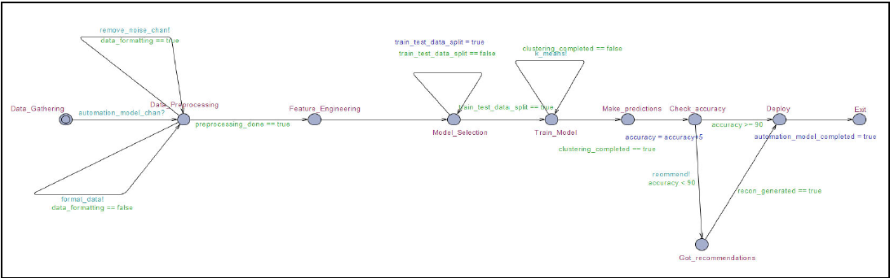
Model Design in Uppaal
Template – automation_model

Slide 7
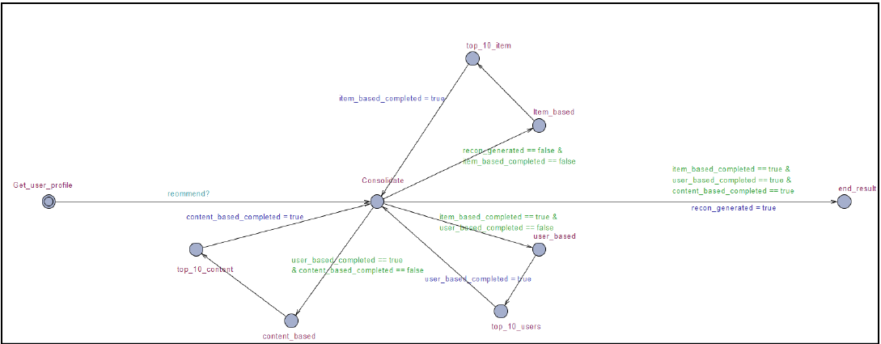
Model Design in Uppaal
Template – recommendation_system

Slide 8
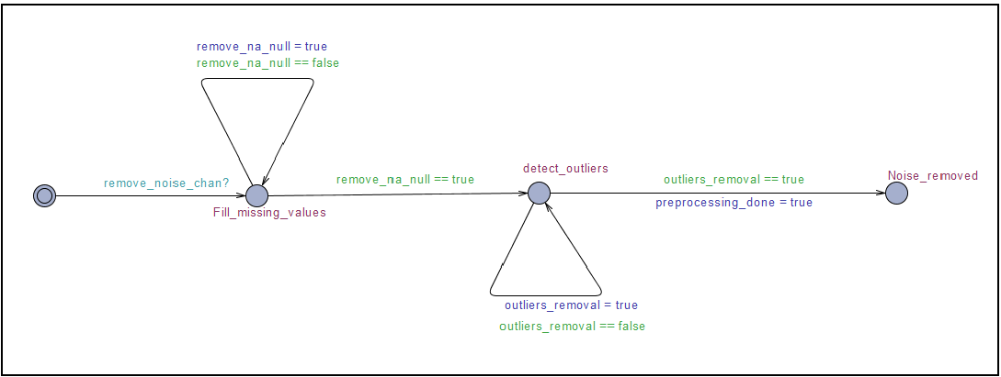
Model Design in Uppaal
Template – remove_noise

Slide 9
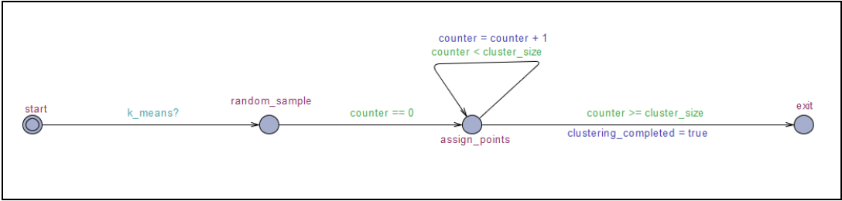
Model Design in Uppaal
Template – k_means_algo

Slide 10
Properties
Reachability Properties
No. | Property | Category
1 | E<> f.logout | Reachability
2 | E<> f.login | Reachability
3 | E<> ( recon_system.end_result ) | Reachability
4 | E<> ( ml_model.Deploy ) | Reachability
5 | E<> ( ml_model.Model_Selection ) | Reachability
6 | E<> ( f.click_content | f.search_content ) | Reachability
7 | E<> f.click_content | Reachability
8 | E<> f.watch | Reachability

Slide 11
Properties
Liveness Properties
No. | Property | Category
9 | A[] ( ((k.counter < k.cluster_size) and clustering_completed == false) or (clustering_completed imply (k.counter >= k.cluster_size) ) ) | Liveness
10 | A[] ( rm_noise.Noise_removed imply (rm_noise.remove_na_null & rm_noise.outliers_removal ) ) | Liveness
11 | A[] ( ml_model.Exit imply automation_model_completed ) | Liveness
12 | A[] ( ml_model.Make_predictions imply ( preprocessing_done & clustering_completed ) ) | Liveness
13 | A[] ( f.profile_creation_process imply (!f.existing_user) ) | Liveness
14 | A[] ( ml_model.Model_Selection imply ( preprocessing_done == true ) ) | Liveness
15 | A[] ( ml_model.Deploy imply ( ml_model.accuracy >= 90 | recon_generated == true ) ) | Liveness
16 | A<> (f.recommend_content imply ml_model.Exit) | Liveness
17 | A<> (f.click_content imply f.check_subscription) | Liveness
18 | A<> (f.login imply f.recommend_content) | Liveness

Slide 12
Properties
Safety Properties
No. | Property | Category
19 | A[] ( f.logout imply !(f.logged_in == false | f.existing_user == false ) ) | Safety
20 | A[] not( ml_model.accuracy >= 90 & recon_generated ) | Safety
21 | A[] ( f.click_content imply ( f.existing_user & f.logged_in & (recon_complete | f.manual_search) ) ) | Safety
22 | A[] (f.watch imply ( f.existing_user and f.content_access) ) | Safety
23 | A[] k.counter <= k.cluster_size | Safety
24 | A[] deadlock imply f.exit | Safety

Slide 13
THANK YOU

